Slide 1



logistic regression: Linear regression is a statistical modeling technique used to establish a relationship between a dependent variable and one or more independent variables. It assumes a linear relationship between the variables and aims to find the best-fit line that represents the relationship. The goal of linear regression is to find the equation of a straight line that minimizes the sum of the squared differences between the actual values of the dependent variable and the predicted values by the linear model. This process is known as "fitting the line" or "training the model."

Slide 2
logistic regression: The equation of a simple linear regression model with one independent variable can be represented as: Y = β0 + β1*X where: - Y represents the dependent variable - X represents the independent variable - β0 is the y-intercept (the value of Y when X is 0) - β1 is the slope (the change in Y per unit change in X)

Slide 3
decision tree A decision tree is a supervised machine learning algorithm that is commonly used for both classification and regression tasks. It is a flowchart-like structure where each internal node represents a test on a feature, each branch represents the outcome of the test, and each leaf node represents a class label or a value. 1. Decision Nodes: Internal nodes in a decision tree represent decisions or tests based on the feature values. The test at each node splits the data into two or more branches, leading to different paths in the tree based on the outcomes of the test. 2. Leaf Nodes: Leaf nodes in a decision tree represent the final predicted class label or the predicted value for a given input. They are the endpoints of the decision process.

Slide 4
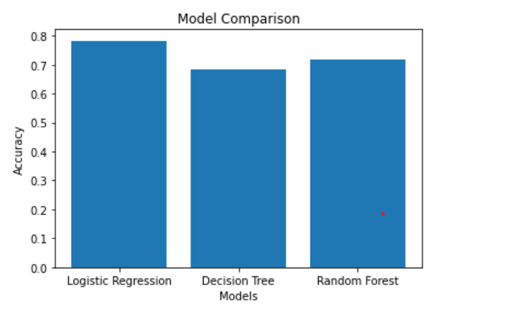
ACCURACY COMPARISION Comparing different model accuracies and visualizing them in a bar graph can provide valuable insights and help in decision-making. The bar plot when three data model accuracies are compared is as follows:

Slide 5
Benefits of this project: 1)Early Detection: Early detection of heart failure risk factors can enable timely interventions and treatments, potentially preventing or mitigating the severity of the condition. 2) Improved Accuracy: Machine learning models can analyze a wide range of patient data and identify complex patterns that may not be immediately apparent to human observers. By leveraging advanced algorithms, machine learning can provide more accurate predictions and risk assessments for heart failure. 3) Personalized Medicine: Machine learning algorithms can take into account individual patient characteristics, such as age, gender, medical history, and lifestyle factors, to create personalized models. These models can predict the likelihood of heart failure and provide tailored treatment recommendations. Personalized medicine can improve patient outcomes by considering specific factors that influence heart failure risk and response to different treatment strategies. Overall, machine learning in heart failure analysis has the potential to improve patient outcomes, optimize resource allocation, and drive advancements in cardiac healthcare by providing accurate predictions, personalized interventions, and valuable research insights.

Slide 6
future scope of improvements Heart failure analysis is an important area of research and has several potential future scope of improvements. Here are a few areas that can be explored for enhancing heart failure analysis: 1. Advanced Machine Learning Techniques: Applying more advanced machine learning algorithms and techniques can improve the accuracy and predictive power of heart failure analysis. For example, deep learning models, such as convolutional neural networks (CNNs) or recurrent neural networks (RNNs), can be explored to extract more intricate patterns and temporal dependencies in heart failure data. Real-Time Monitoring and Alert Systems: Developing real-time monitoring systems that leverage wearable devices and Internet of Things (IoT) technologies can enable continuous tracking of heart failure patients. These systems can provide timely alerts, detect early signs of deterioration, and facilitate proactive interventions to prevent adverse events.

Slide 7
future scope of improvements Feature Engineering and Selection: Developing innovative feature engineering and feature selection techniques can help identify the most relevant and informative features for heart failure analysis. This can involve incorporating domain knowledge, exploring new biomarkers or imaging features, or utilizing feature selection algorithms to automatically identify the most predictive features.

Slide 8


